Slide 1
Telecom Industry Customer Churn Prediction
Team Number: 6
Submitted for DATS 6101

Slide 2
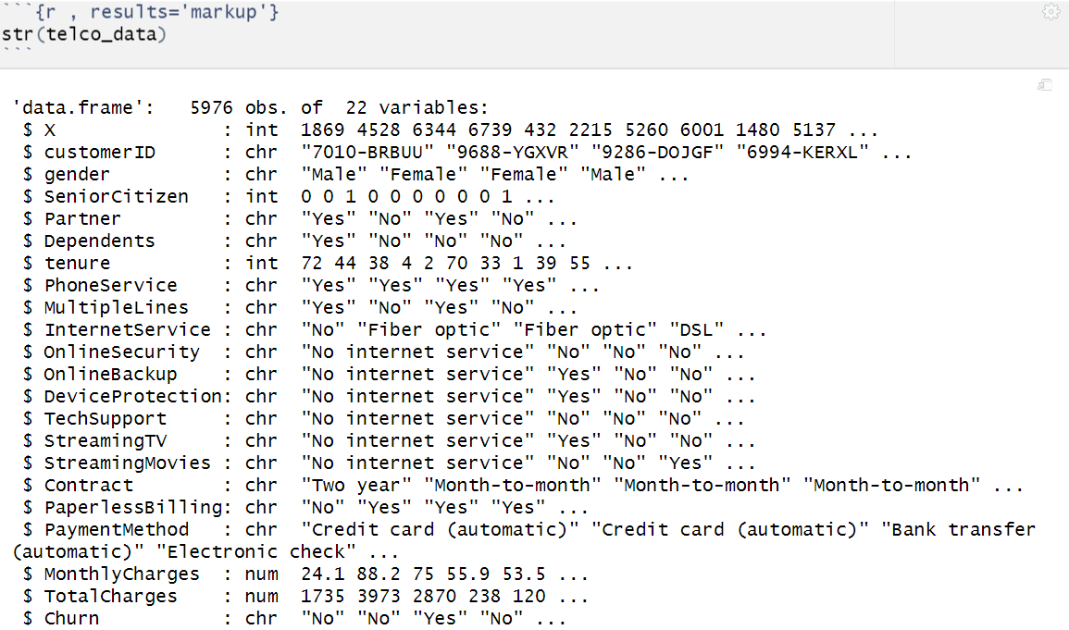
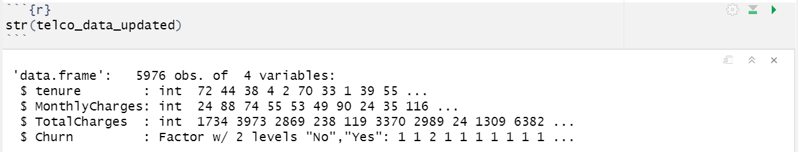
KNN Model-Data Selection/Validation

Slide 3
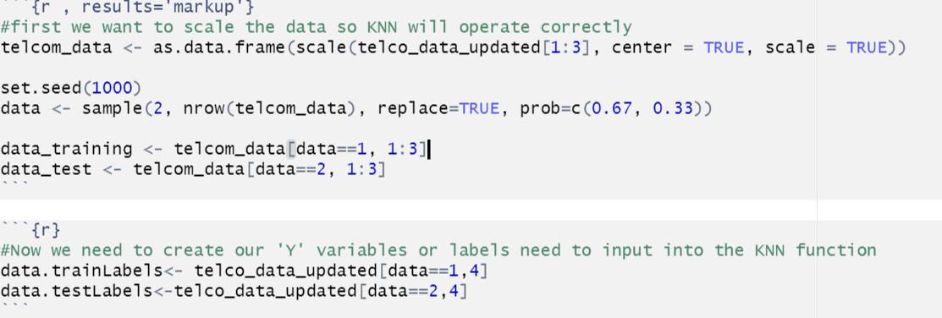
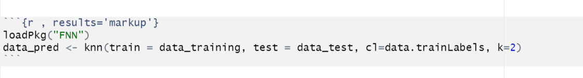
KNN Model-Model Building

Slide 4
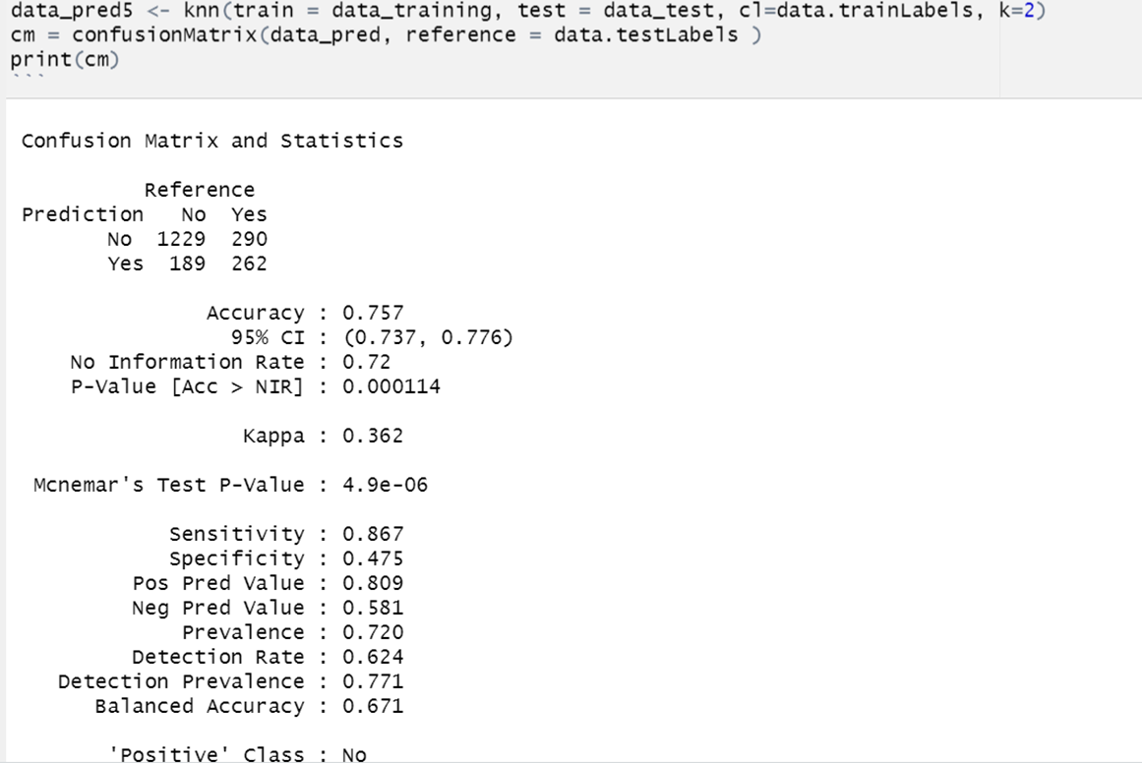
KNN Model-Confusion Matrix-Accuracy

Slide 5
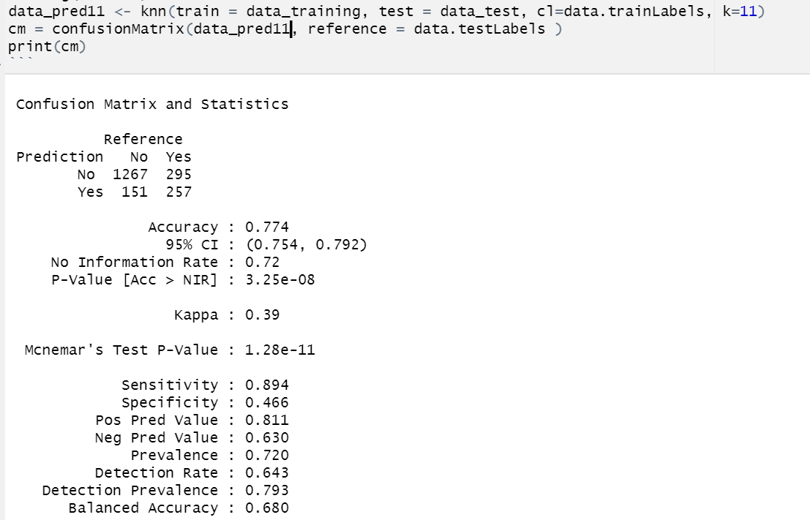
KNN Model-Confusion Matrix-Accuracy

Slide 6
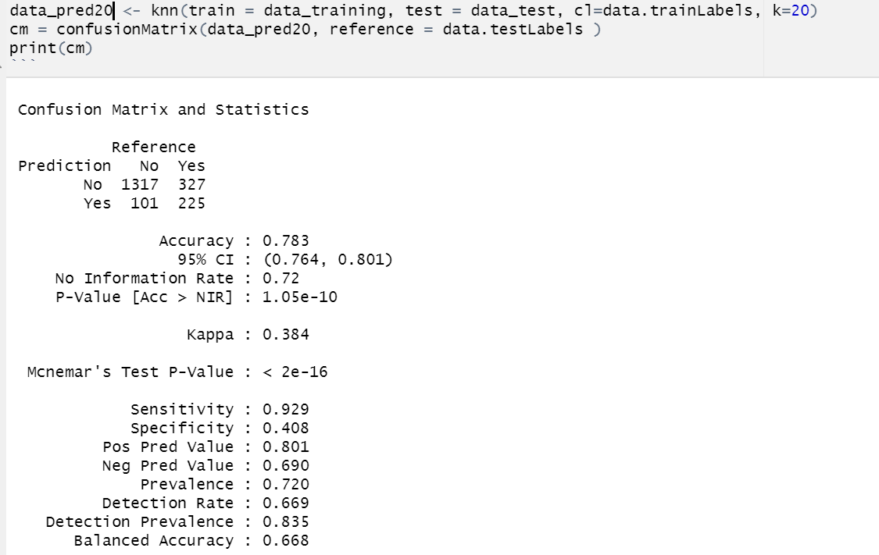
KNN Model-Confusion Matrix-Accuracy

Slide 7
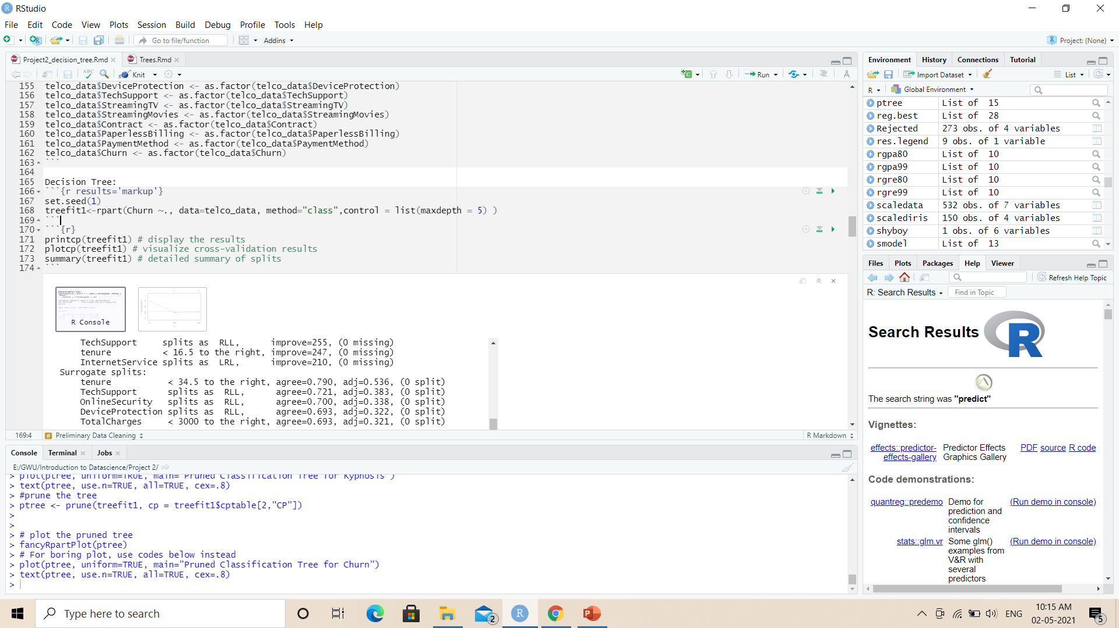
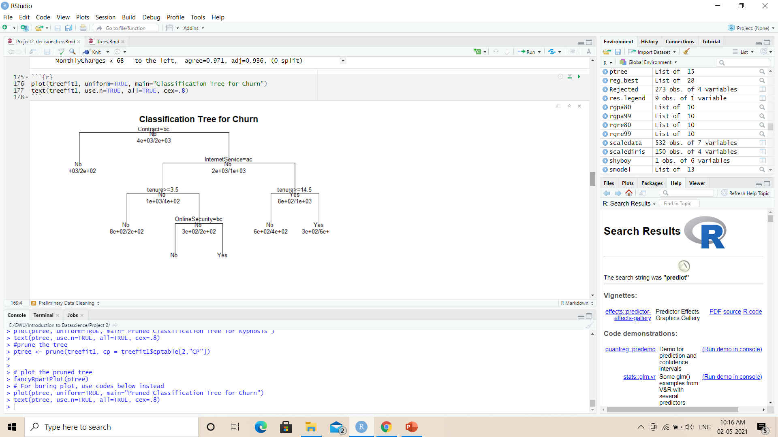
Decision Tree model

Slide 8
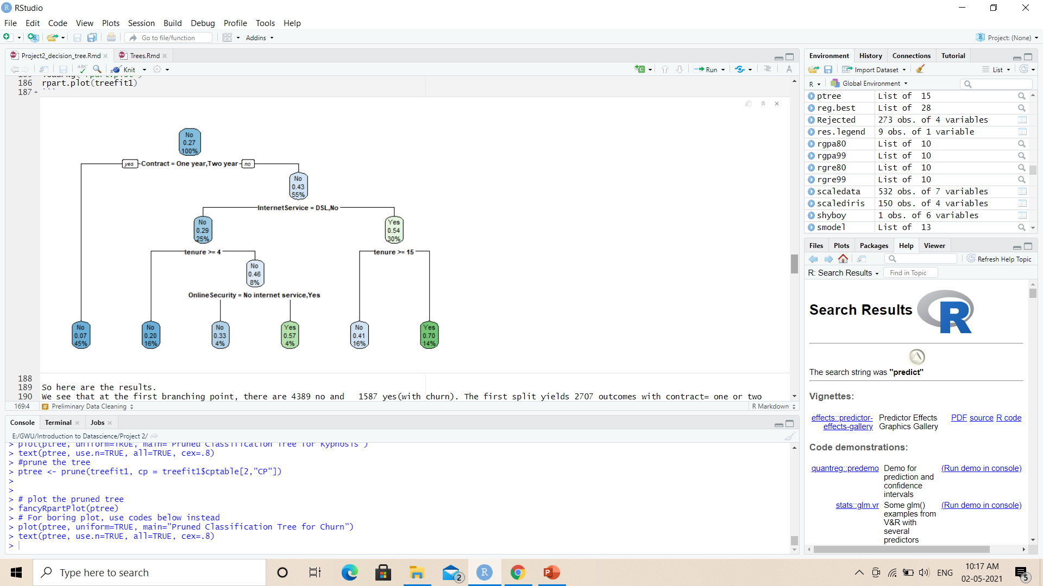
Decision Tree model
The first branching point, there are 4389 no and 1587 yes (churn)
The first split yields 2707 outcomes with contract= one or two years and 3269 outcomes with contract= month to month

Slide 9
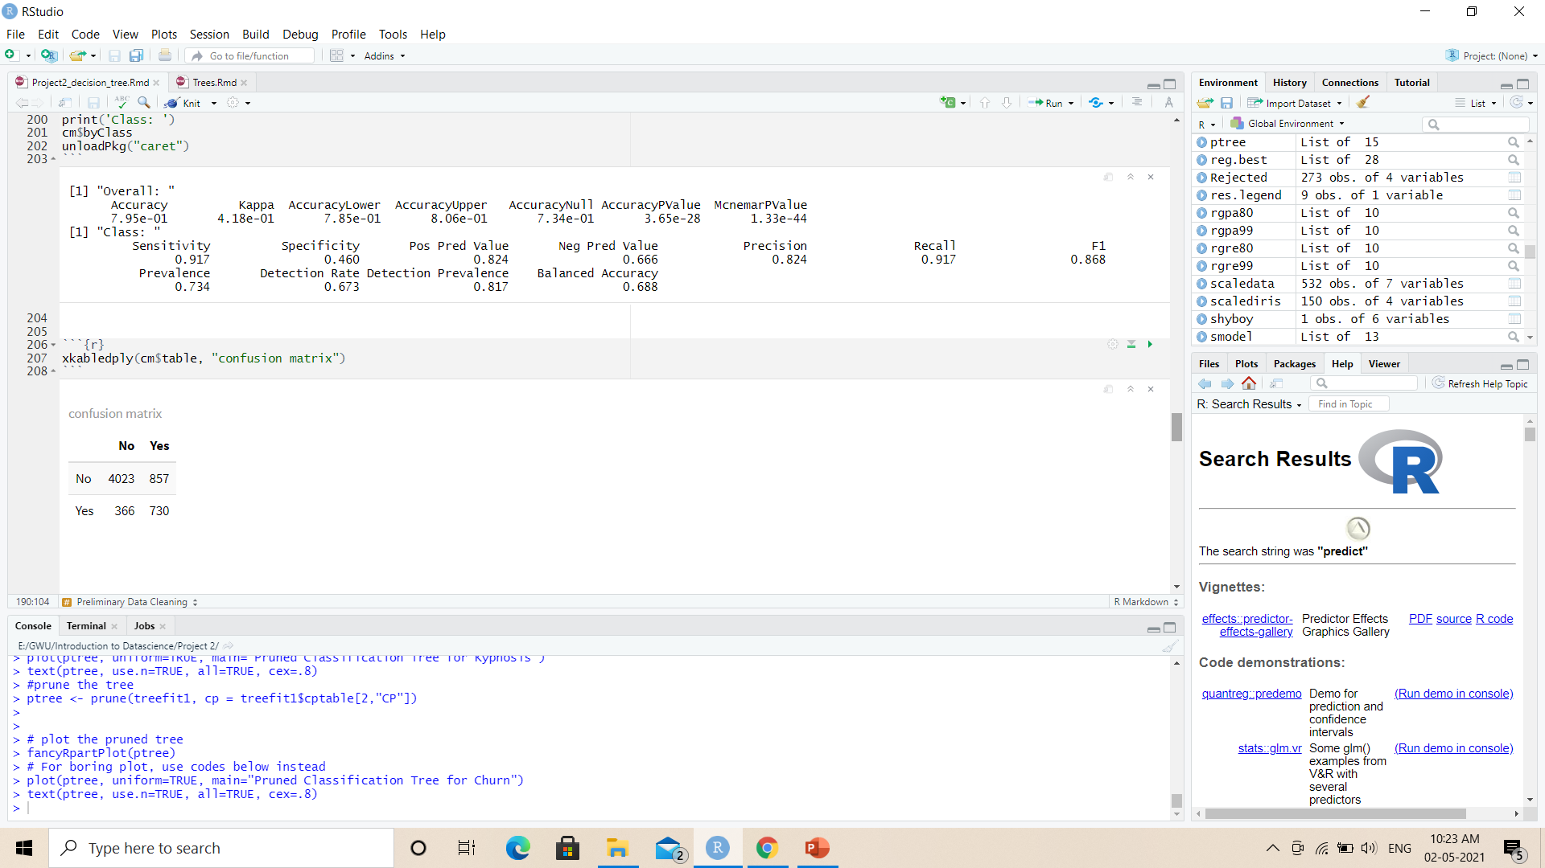

Decision Tree model
The overall accuracy of model is 79.5%

Slide 10
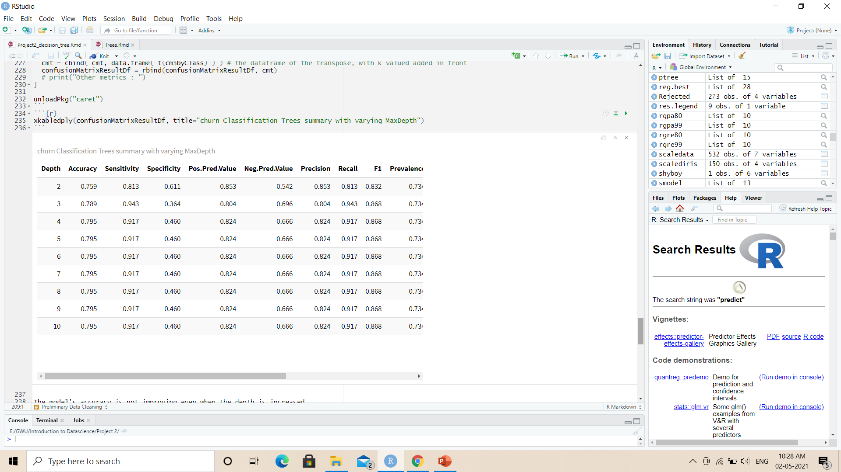
Decision Tree model
Let us try different maxdepths to check whether there is an improvement in model
The model's accuracy is not improving even when the depth is increased.

Slide 11
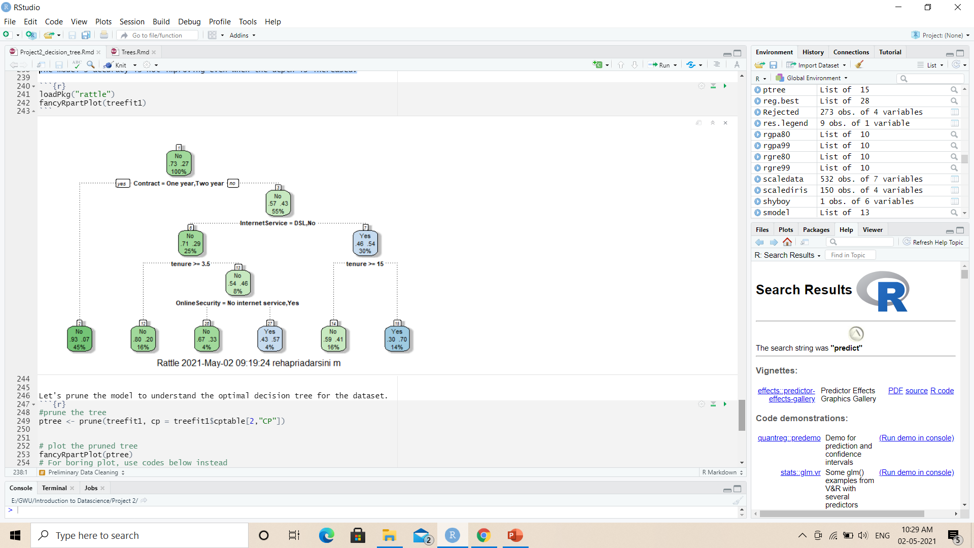
Final Decision Tree model

Slide 12
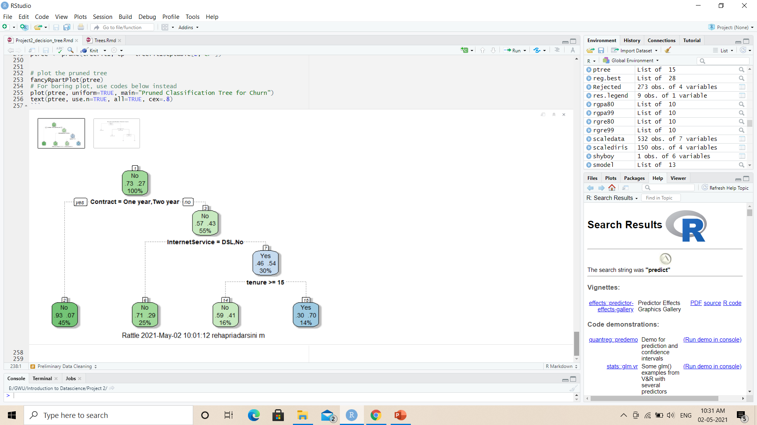
Pruned Tree

Slide 13

GitHub
GitHub link:
https://github.com/adingankar/DATASCIENCE_6101/tree/main/Project%202

Slide 14
Any Questions?

